Slide 1
Employee Data Analysis using Excel
STUDENT NAME:Sathya sree.M
REGISTER NO:312200200
DEPARTMENT:B.Com(general)
COLLEGE: SIVET college Gowrivakkam

Slide 2
PROJECT TITLE
Employee Performance Analysis using Excel

Slide 3


AGENDA
Problem Statement
Project Overview
End Users
Our Solution and Proposition
Dataset Description
Modelling Approach
Results and Discussion
Conclusion
3/21/2024 Annual Review

Slide 4

PROBLEM STATEMENT
Employee performance analysis:
Employee performance analysis is a process used to evaluate and measure on employee's job performance
1. Job knowledge
2. Communication and teamwork abilities

Slide 5

PROJECT OVERVIEW
Performance analysis:
.
I used employee name , employee's gender , performance of employee,rating which is used to analysis the performance of employee's
I have created a pivot table for analysing

Slide 6
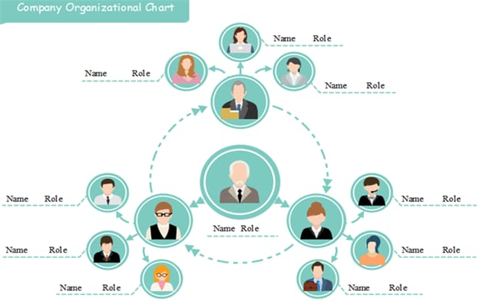

WHO ARE THE END USERS?

Slide 7

OUR SOLUTION AND ITS VALUE PROPOSITION
Solution overview:
Implement a performance analysis system utilising advanced analytics and machine learning
Methodology:
Integrate data from various sources to create a comprehensive performance profile and use predictive analytics to forecast future performance
Implement a performance analysis system utilising advanced analytics and machine learning

Slide 8
Dataset Description
Data sources:
Employee performance reviews, productivity metrics,training records,and feedback surveys.
Attributes:
Performance ratings,completion of goals, attendance records,and peer feedback.

Slide 9
MODELLING
Employee program analysis modelling involves using statistical and analytical techniques to evaluate the effectiveness of employee programs, such as training, development, and engagement initiatives.
1.Define objectives and scope
2.System understanding
3.Model development
4. Choose the modeling technique
10

Slide 10
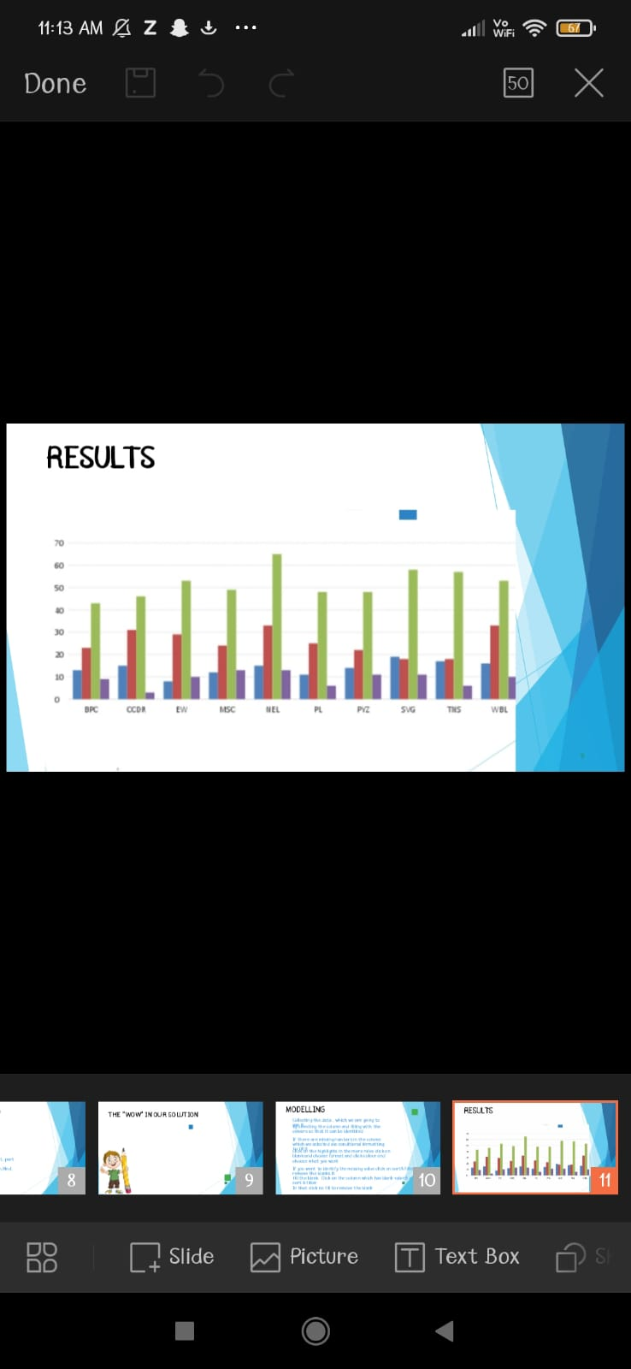
RESULTS
11

Slide 11
conclusion
By addressing these areas ,we can optimize resources,improve efficiency,and drive growth.Regular monitoring and evaluation will ensure continued progress and success.

